Slide 1
Medical Cost Prediction Using Machine Learning
By Anwar Basha

Slide 2
Introduction
Medical costs are influenced by a multitude of factors, ranging from demographic information and lifestyle choices to pre-existing medical conditions and regional healthcare policies
In this project, we aim to develop a machine learning model that predicts medical costs based on various input features such as age, gender, BMI, smoking habits, geographical location, and pre-existing conditions

Slide 3
Objective of Medical Cost Prediction
Financial Planning and Management
Insurance Premium Calculation
Risk Management
Policy Development and Regulation

Slide 4
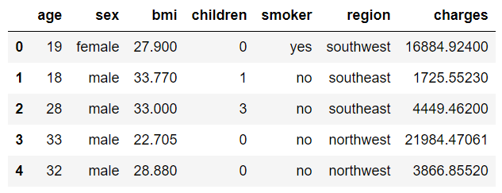
Dataset Analysis
The dataset utilized for this project comprises 1338 observations and 7 columns
An overview of the dataset reveals..

Slide 5
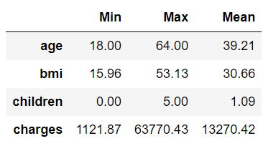
Statistical Analysis of Numerical and Categorical Data

Slide 6
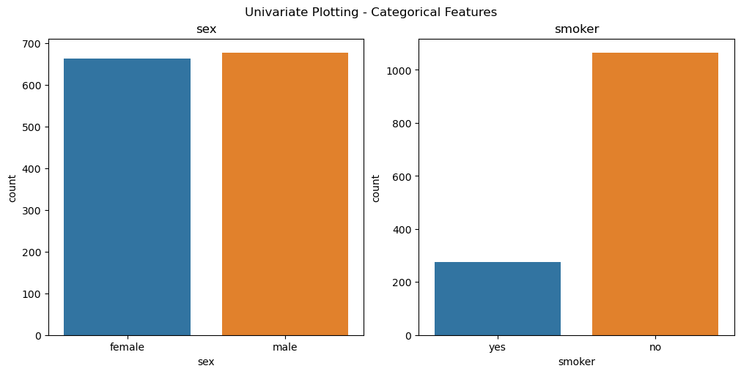

Slide 7
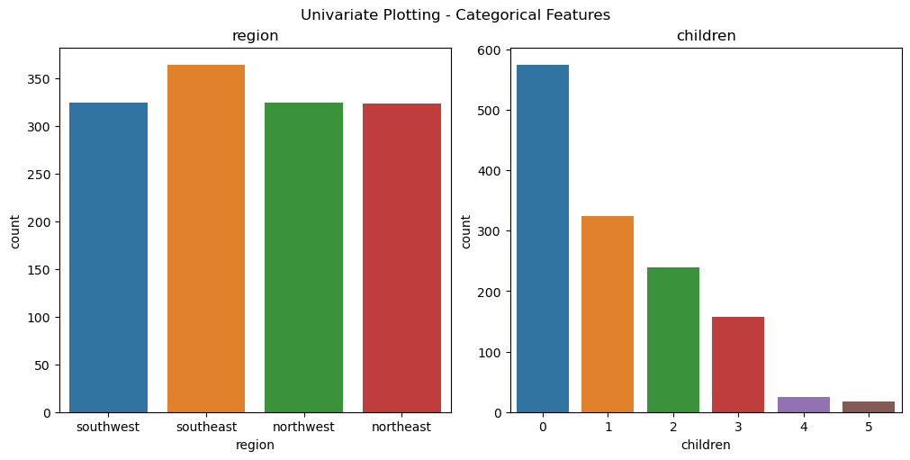

Slide 8
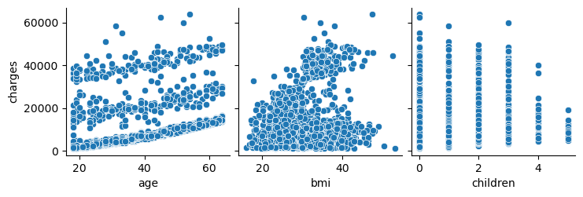
Analysis of Medical Cost

Slide 9
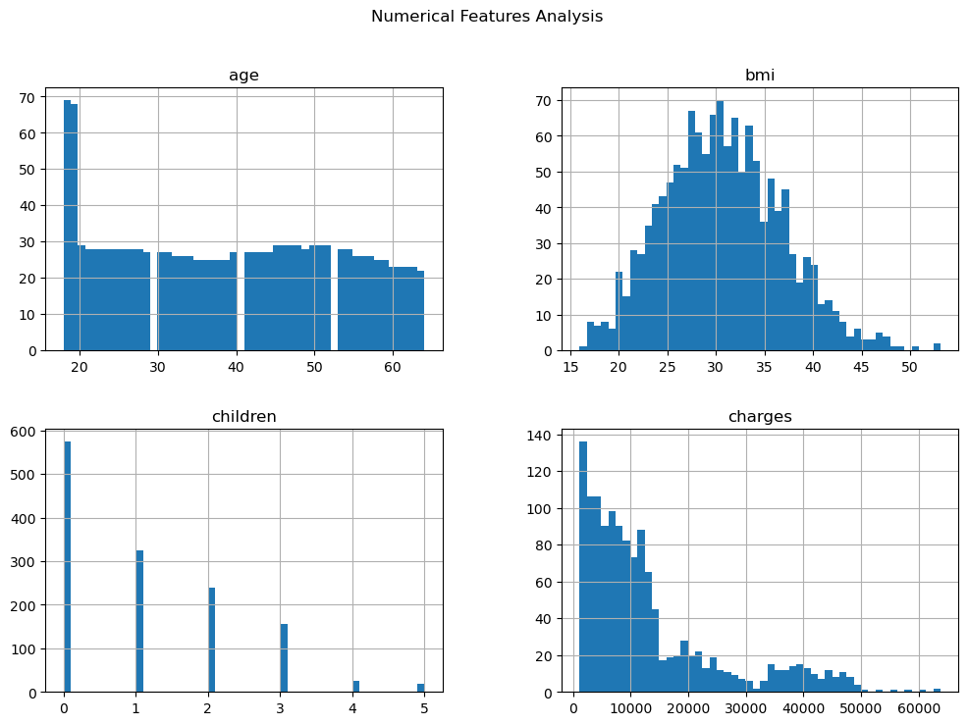

Slide 10
Methodology
Data Splitting
Preprocessing
Convert categorical into numerical
Model Training
Employing various algorithms for model training
Testing Data (25%)
Scaling numerical values
Evaluation
Evaluating trained models utilizing diverse metrics
Identify Target Variable
Training Data (75%)

Slide 11
Data Set
(1338*7)
Training Data
(1003*6)
Testing Data
(335*6)
Categorical Training Data
Numerical Training Data
Categorical Testing Data
Numerical Testing data
Encoding
Scaling
Encoding
Scaling
Final Training Data
Final Testing Data

Slide 12
Data Splitting
Partitioning the data into training (75%) and testing (25%) sets using the train-test split method
Identifying the target variable within the dataset and subsequently segregating it from the dataset for model training purposes. This variable is withheld for analyzing model performance.
The training dataset comprises 1003 observations across 6 columns, while the testing dataset consists of 335 observations with a single column

Slide 13
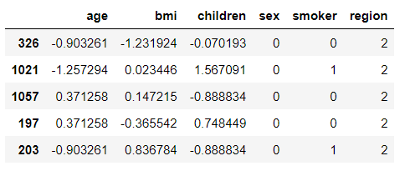
Data Preprocessing
Transforming categorical data into numerical values via Label Encoder
Enhancing model performance by scaling numerical features using Standard Scale
An overview of the training dataset after preprocessing reveals..

Slide 14
Model Training and Evaluation
Types of Algorithm
KNN
Evaluation Metrics
Mean Absolute Error
Linear Regression
Support Vector Machine
Decision Tree
Random Forest
Mean Squared Error
R2

Slide 15
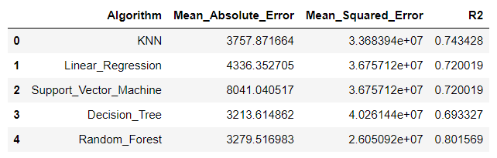
Performance Analysis

Slide 16
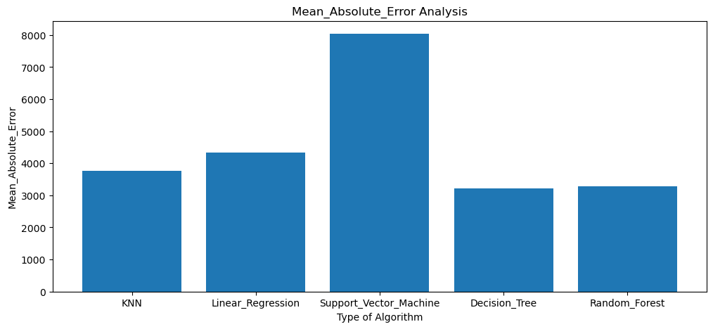

Slide 17
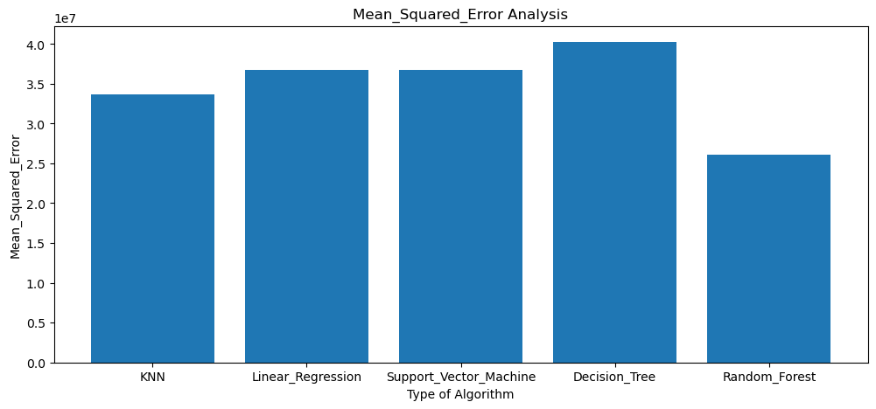

Slide 18
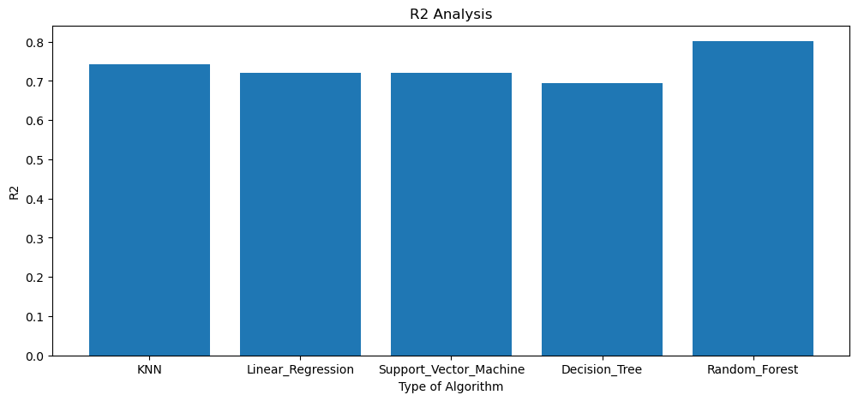

Slide 19
Conclusion
The Random Forest model emerges as the top performer among all algorithms utilized in the analysis, showcasing superior predictive capabilities.
Evaluation based on R2 scores indicates that the Random Forest algorithm achieves an impressive predictive accuracy of approximately 80%, underscoring its effectiveness in forecasting health insurance costs.

Slide 20
Thank You

